Slide 1
HPAI Monitoring Capstone Defense
Kathryn Fillman
Bioinformatics and Computational Biology, University of Minnesota
Notes:
Good morning
I am Kathryn Fillman
Defense for my master’s capstone defense which focuses on proposing monitoring locations for the entrance of HPAI into the US

Slide 2
Introduction to Avian Influenza
Highly pathogenic avian influenza (known as H5N1 or HPAI) is a subtype of Influenza A virus. Avian influenza is categorized as having either low (LP) or high pathogenicity (HP)¹.
LPAI is endemic in waterfowl populations; terrestrial species, such as turkeys and chickens, are not natural hosts¹.
HPAI viruses of clade 2.3.4.4b underwent an explosive geographic expansion in 2021, spreading to North America and infecting wild birds and domestic poultry².
The virus’ first introduction to North America was in Newfoundland and Labrador, Canada in November 2021.
The virus soon entered the US in December of 2021.
Notes:
Influenza A Info
Part of the Orthomyxoviridae virus family
classified by the serological subtypes of the primary viral surface proteins, the hemagglutinin (HA) and neuraminidase (NA). There are 16 and 9 subtypes respectively.
Negative sense RNA virus (codes for RNA-dependent RNA polymerase, causing many point mutations)
The build up of mutations (creating a new subtype) is known as antigenic drift
Enveloped (by HA and NA)
Segmented genome (8 strands of negative RNA)
Co-infections that cause reassortment is known as antigenic shift
Non-neutralizing antibodies (bind to pathogen but do not affect infectivity)
Infection Mechanisms
HA binds to sialic acid on epithelial cells
Due to the fact that avian influenza is most commonly a call for concern in the farming industry, it is important to note that LPAI is endemic in waterfowl populations, but not in terrestrial populations
Most recent outbreak is from the 2.3.4.4b clade
Previously referred to as Eurasiasn strain
Recombined with north American strain soon after entering NA
This was the second time H5 entered the US, the first being 2014 when it entered via the bearing straight and joined the pacific flyway.

Slide 3
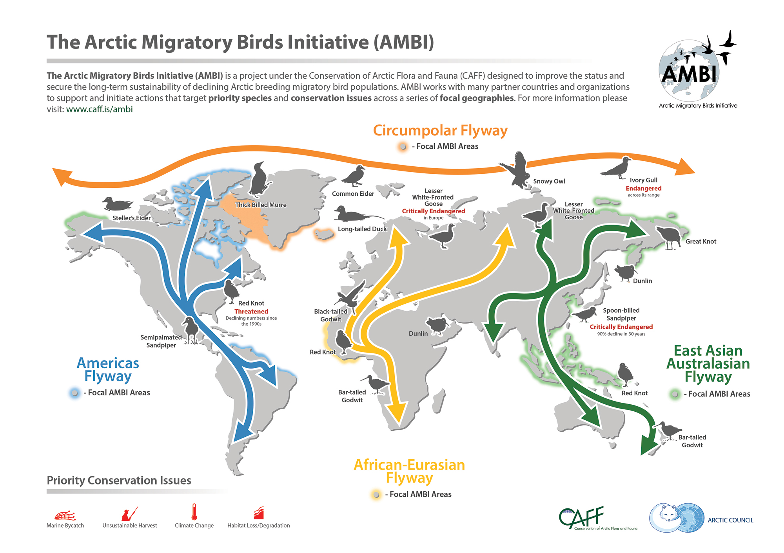
Via AMBI
Notes:
https://e-publications.nefco.org/psi-ambi-2020/#35276
Flyways are flight paths used by a large number of birds while migrating
describe broad, generalized pathways that are not defined routes and not used by all migrating birds

Slide 4
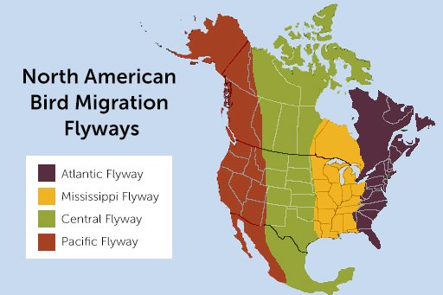
Via American Bird Conservatory
Notes:
https://abcbirds.org/blog/north-american-bird-flyways/
Kinda split up my time zones (sort but not rly)

Slide 5
Introduction to Avian Influenza
HPAI seems to be associated with the adaptation of LPAI to gallinaceous birds. Once infected, the virus has the potential to mutate into HPAI, which has been observed to occur within weeks or years. Waterfowl can then be infected and carry HPAI¹.
There are no pathognomonic signs for either HPAI or LPAI, so infections must be confirmed by a laboratory test. Molecular criteria has been established by the World Organization for Animal Health (WOAH) based on the protein sequences of the HA proteolytic cleavage site (PCS)¹.
Prior to the availability of lab tests, manual classification of HPAI involved the disease killing at least 75% of susceptible 4–6-week-old chickens within 10 days of infection. Clinical signs include neurological distress, fever, swollen heads, and hemorrhages in chickens¹.
Notes:
gallinaceous- relating to birds of an order (Galliformes) which includes domestic poultry and game birds aka turkeys and chickens
No pathogomonic distinction between hpai and lpai, so a lab test is required to confirm
most HPAI strains will cause 100% mortality within 36-48 hours (about 2 days) of infection.
Neurological distress is more common in turkeys than chickens.

Slide 6
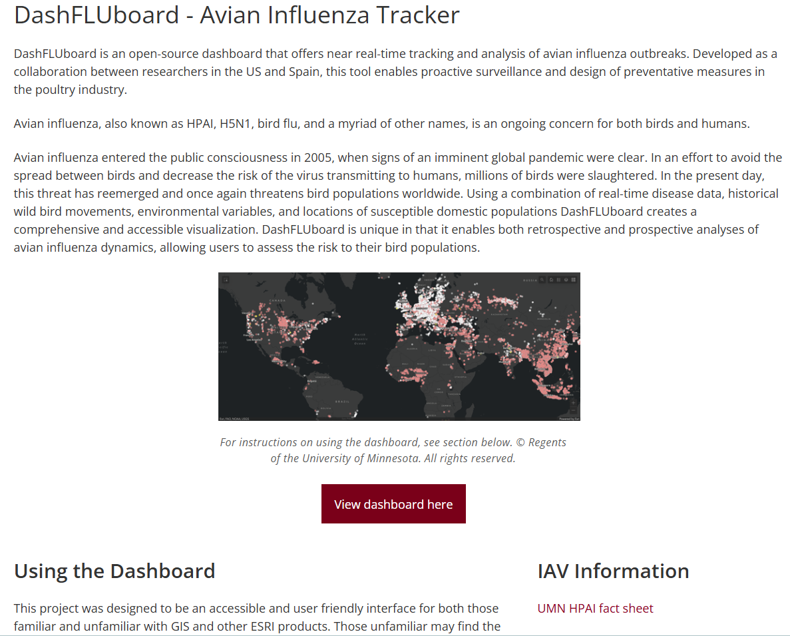
DashFluBoard Webpage
The webpage houses a link to the dashboard, a brief explanation of the tool and how to use it, and links to more information on IAV.
Notes:
A Tool that is useful in the tracking and monitoring of HPAI outbreaks and spread is DashFluBoard designed by Seunghyun Lim
DashFluBoard combines data on a number of factors associated with increase in risk for HPAI and displays them on interactive maps.
3 tabs show outbreak records, worldwide temperatures, and wildbird movements
I oversaw the creation of the webpage.

Slide 7
Current Risk
The most recent pandemic began in 2021³.
In October 2023, HPAI was detected in Antarctica for the first time⁴.
On May 15, 2024, the first report of clade 2.3.4.4b virus exhibiting direct contact and airborne transmissibility in ferrets was published⁵.
On May 30, a third human case of HPAI related to a multi-state outbreak of HPAI in dairy cattle was reported. This brings the total number of human cases in the US since 2022 to 4⁶.
The US has the highest number of cases in mammals worldwide⁷.
While there have been projects identifying pathways of disease entrance into the EU, the same has not been done for the US⁸.
Notes:
Antarctica was previously the only major geographical region where HPAI was not detected
Highest mammals likely primarily due to land mass
Second case of human HPAI in Michigan (related tot his outbreak). 9 states with outbreaks in cows

Slide 8
Project Goal
Identify potential sources of disease introduction into each US state & find locations that can be used as ‘warning alarms’ for HPAI outbreaks in the US.

Slide 9
Identifying Monitoring Locations

Slide 10
Methodology
Data used included…
World outbreak data from Jan 2020-Sep 2023.
A shapefile containing geodata and country codes.
A banding file containing locations where birds were tagged and recovered.
Created list of US states and the date of their first infection
Notes:
Outbreak data from WOAH
Intergovernmental organization founded in 1924 with the primary objective of controlling and preventing the spread of epizootic diseases
They track a number if disease including hpai
Shapefile from dashfluboard
simple, nontopological format for storing the geometric location and attribute information of geographic features.
Banding from BBL
Collaboration between the US geological survey & Canadian wildlife service bird banding office which began in 1920 and supports to collection, archival, and dissemination of data from banded and marked birds throughout North America
From that, I started by creating a list of US states & the date the disease was first detected within them

Slide 11
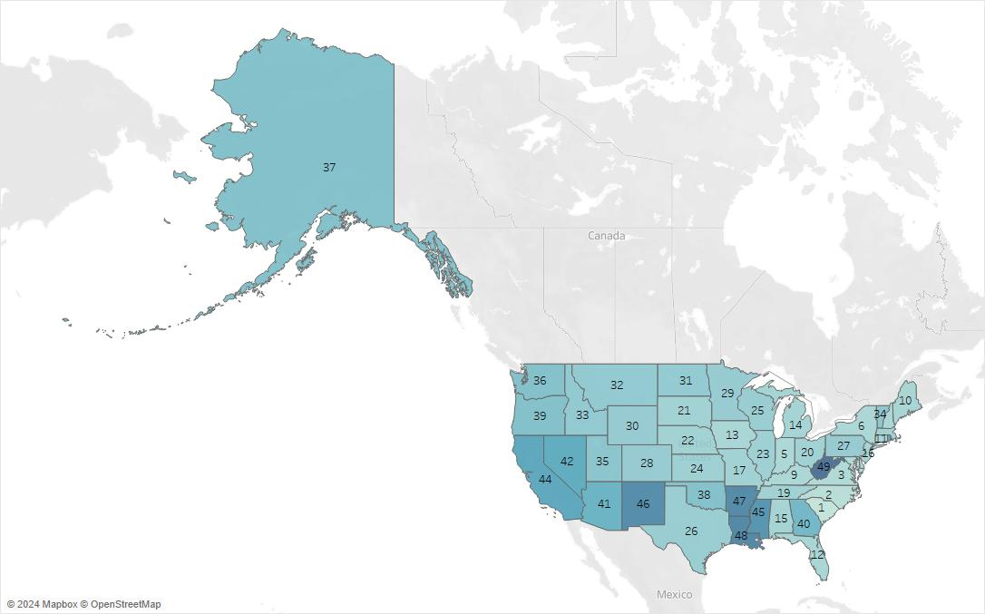
Notes:
Map showing the spread of hpai thorough the untied states, color coded by date of infection
Labels based on what number state they were to be infected
Lighter colors indicate an earlier infection.
Disease first appeared in south Carolina Dec 30 2021
Last state to be infected was West Virginia almost a year later on Dec 16, 2022
Hawaii is not included as the data did not include any entries in Hawaii. (only 49 states)
Entered in SC and spread west

Slide 12
Methodology
Joined world outbreak data and banding data via shapefile
Generated a list of candidate sources of infection using the criteria:
Outbreak began 3-31 days prior to state’s first outbreak
Known migratory connection to state
Notes:
In order to find monitoring locations, I created a function that searched for outbreaks prior to those with the US given my criteria
First had to join outbreak and banding data using the shapefile
Had to use shapefile bc world outbreak data used three letter ISO (ISO 3166-1 alpha-3) codes and the banding file used FIPS codes, which only use 2 letters
Then was able to filter outbreak events
3 days prior to state outbreak bc that is when symptoms begin to appear
No more than 31 days to ensure the outbreaks are related and the scope of the search is not too large
Connections are to country or province/state

Slide 13
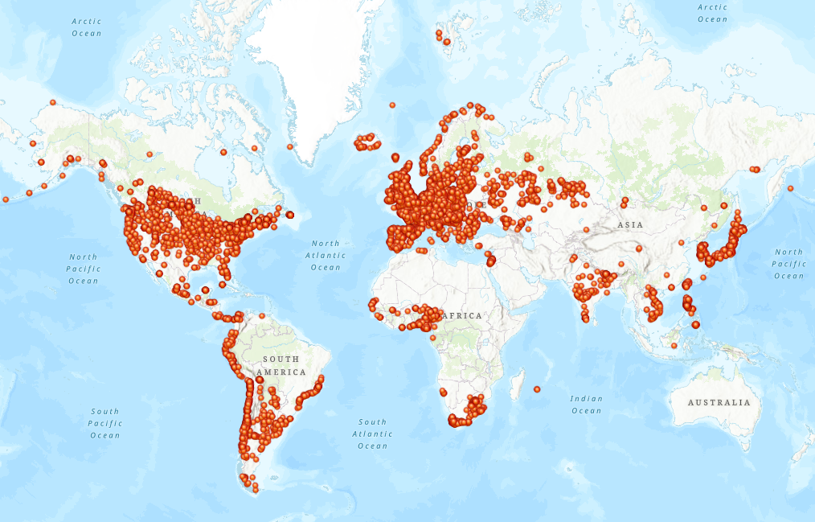
Notes:
All locations in the world outbreak data
Shown to visualize the availability of data, which is not uniform throughout the world

Slide 14
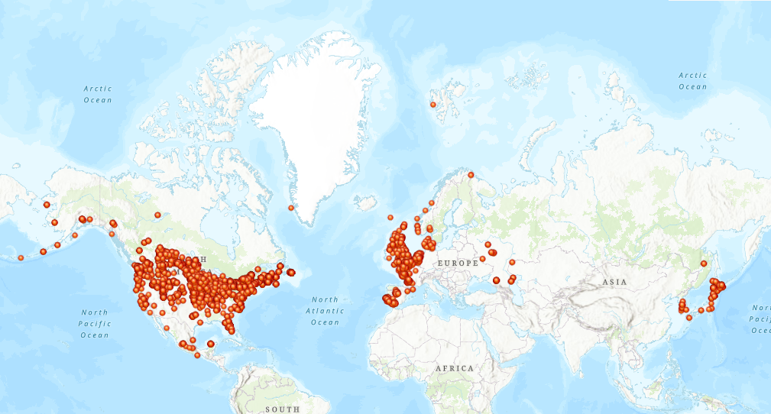
Notes:
All candidate source locations
2048 unique potential source events

Slide 15
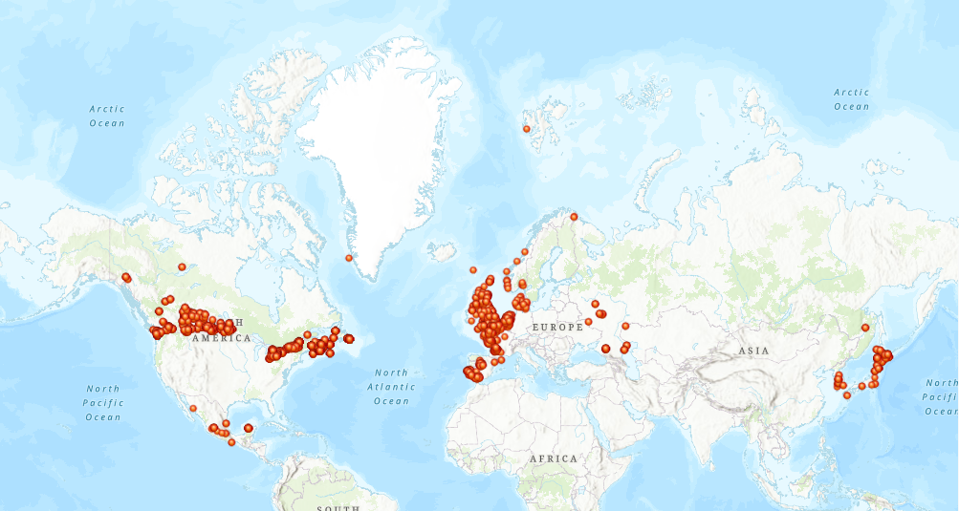
Notes:
Candidate source locations minus us bc we are looking for exterior locations for monitoring
16 countries (excluding the US)
1243 potential source events excluding those originating in the US
France: 350
Canada: 258
Netherlands: 184
United Kingdom:153
Japan: 101
Korea (Rep. of): 19
Portugal: 19
Norway:15
Russia: 15
Ireland: 5
Faeroe Islands: 1
Greenland: 1

Slide 16
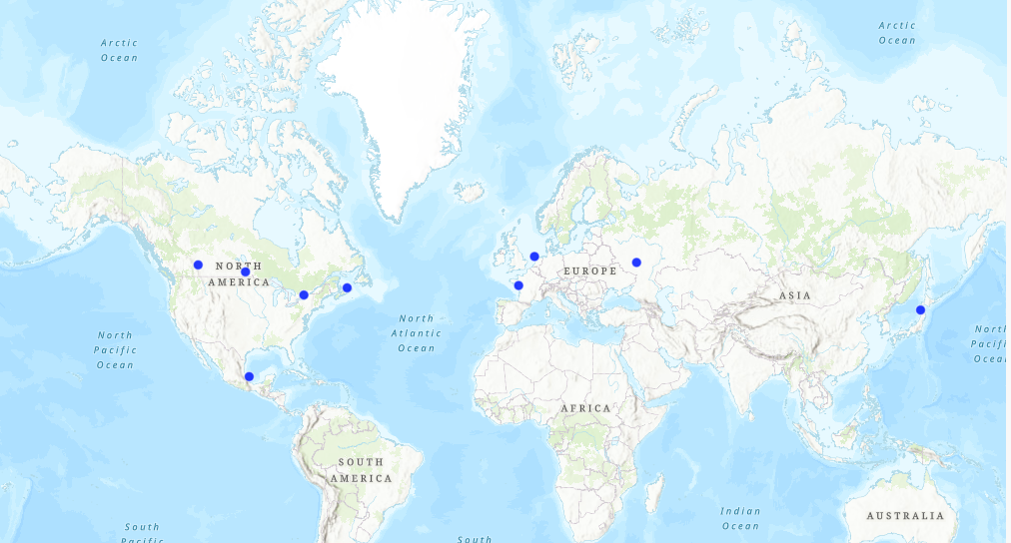
Using the list of candidate sources, a weighted K-means algorithm was used to generate centroids, which were then used to identify potential monitoring locations.
Notes:
Decided to use prototype-based clustering bc it was easy to identify number of monitoring locations and get baseline of meaningfully ‘central’ points.
Run a DBSCAN (graph-based) to idenfify outlier points + visualize clusters that way, but due to lack of ability to handle different cluster densities it didn’t produce meaningful results
Chosen over density based & graph based clustering bc it gives centroids. Also can handle differing cluster densities and can find not well separated clusters (versus graphing methods)

Slide 17
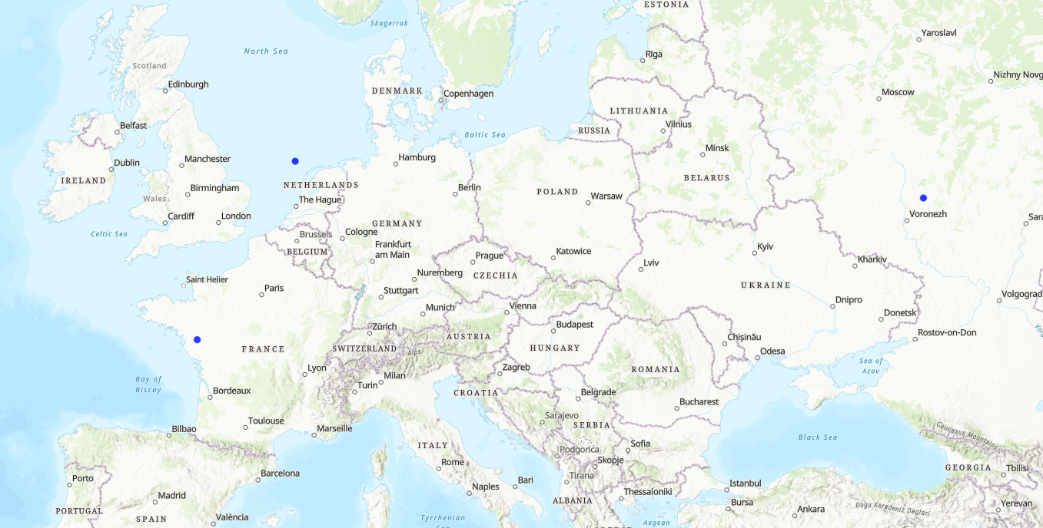
Notes:
European/Asian centroids

Slide 18
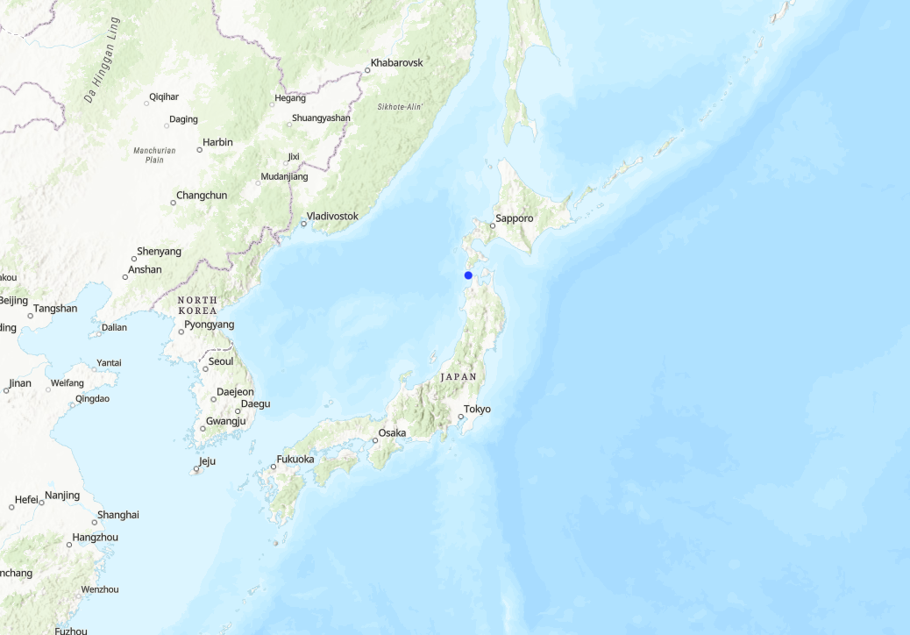
Notes:
Japan centroid

Slide 19
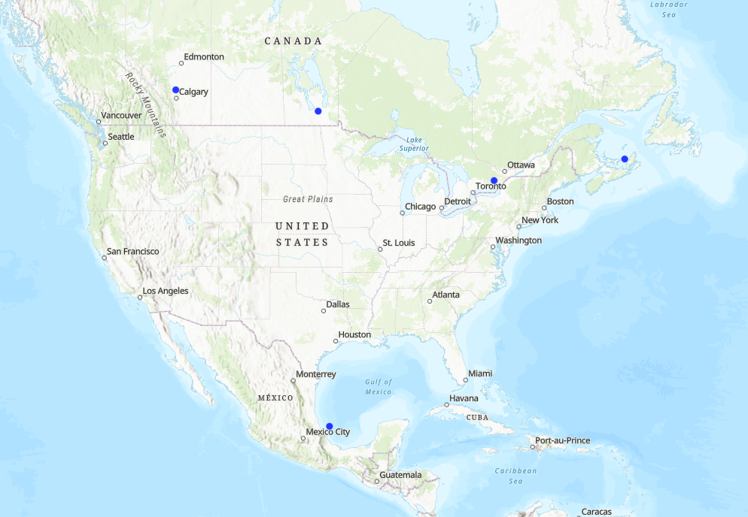
Notes:
Americas centroids

Slide 20
Methodology
Centroid Issues:
Four centroids in water
One centroid in location with few events (spilt between two population centers)
Centroids with issues were reassigned to the nearest location of high activity
Notes:
Ressigned to closest country & closest location with relatively high numbers of outbreaks
Proposed monitoring locations:
Kuji, Iwate, Japan
Izobil'nenskiy rayon, Stavropol', Russia
Aberdeenshire, Scotland, UK
Maine-et-Loire, Pays de la Loire, France
Umán, Yucatán, Mexico
Halifax, Nova Scotia, Canada
York, Ontario, Canada
Division No. 2, Manitoba, Canada
Division No. 11, Alberta, Canada

Slide 21
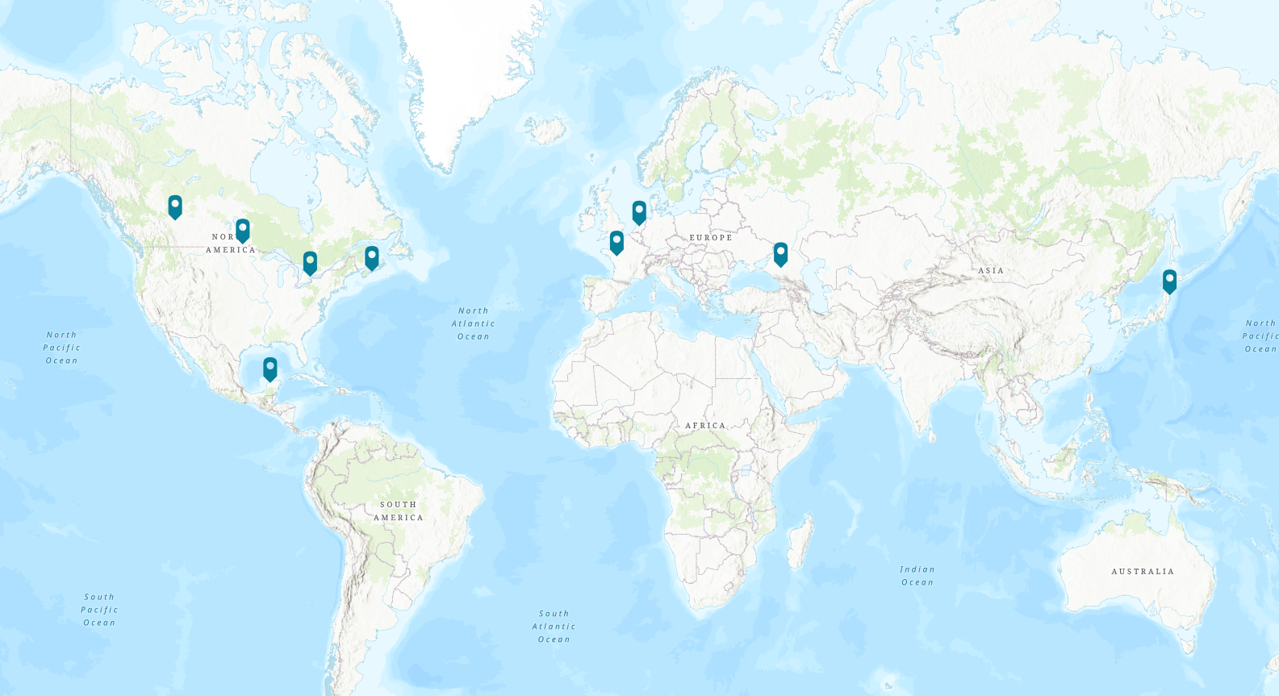
Notes:
Proposed monitoring locations:
Kuji, Iwate, Japan
Izobil'nenskiy rayon, Stavropol', Russia
Aberdeenshire, Scotland, UK
Maine-et-Loire, Pays de la Loire, France
Umán, Yucatán, Mexico
Halifax, Nova Scotia, Canada
York, Ontario, Canada
Division No. 2, Manitoba, Canada
Division No. 11, Alberta, Canada

Slide 22
Results

Slide 23
Results Analysis
No outbreak data for Hawaii.
France is not a meaningful monitoring location.
All states (including Hawaii) are covered by at least 2 monitoring locations.
Notes:
No Hawaii = not the most accurate picture of spread
France only has connections to 2 states. So although it is abundant as a potential source it is not as meaningful as a monitoring location.

Slide 24
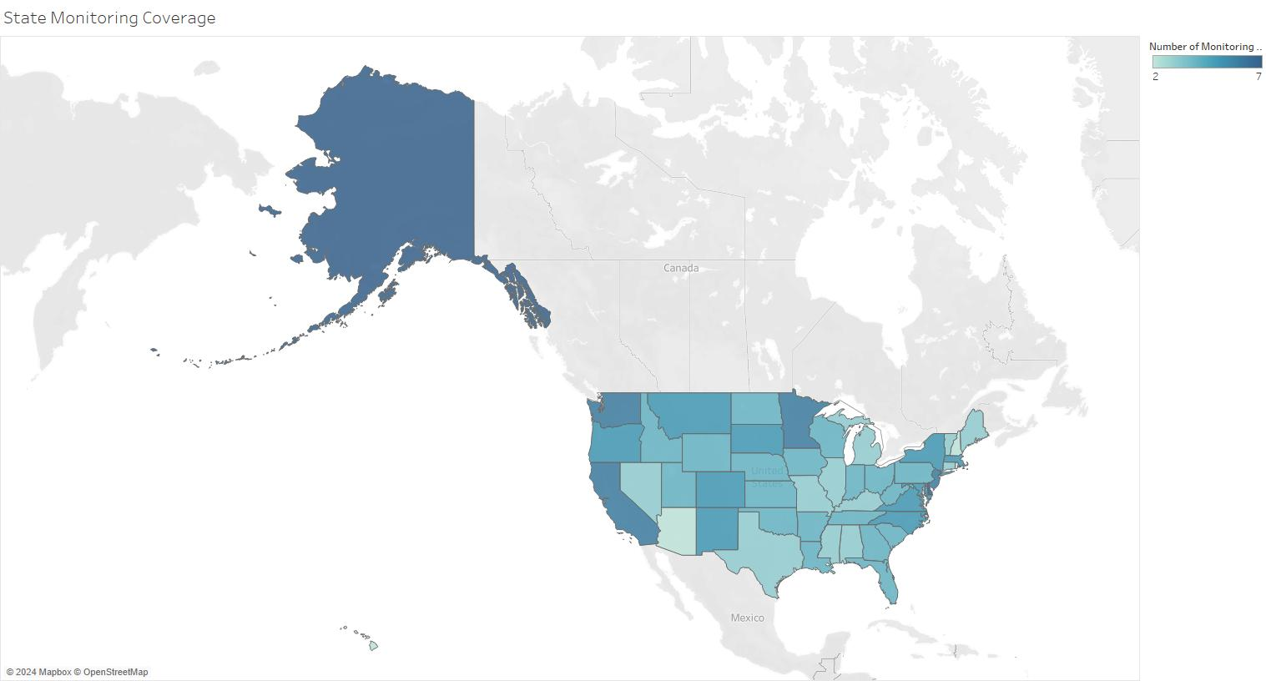
Notes:
Map of number of monitoring locations per state. Lighter colors indicate less monitoring.
Least covered states (with only 2 monitoring locations): Arizona, Hawaii, New Hampshire, Rhode Island
Most covered states (7 monitoring locations): Delaware and Alaska

Slide 25
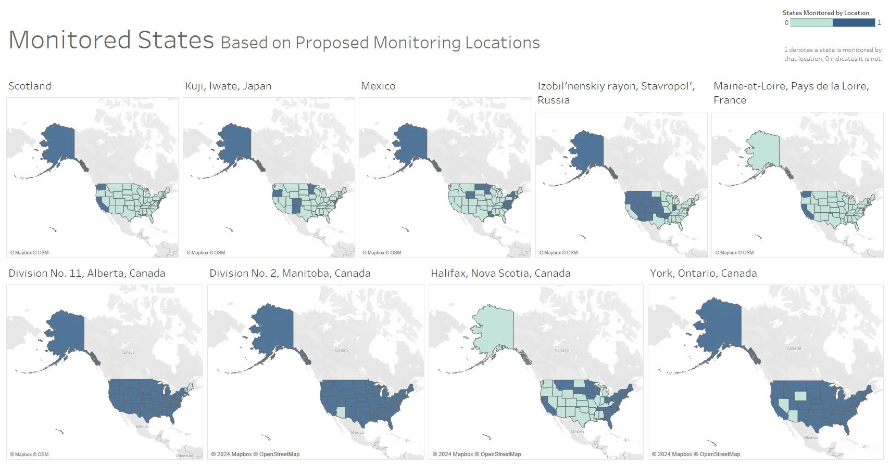
Notes:
Aberdeenshire, Scotland, UK: 6
Kuji, Iwate, Japan: 7
Umán, Yucatán, Mexico: 13
Izobil'nenskiy rayon, Stavropol', Russia: 18
Maine-et-Loire, Pays de la Loire, France: 2
Division No. 11, Alberta, Canada: 43
Division No. 2, Manitoba, Canada : 46
Halifax, Nova Scotia, Canada: 24
York, Ontario, Canada: 46

Slide 26
Discussion
Early warning and detection are integral to mitigating disease spread and limit population culling
Lead time given by monitoring (avg of 16 days) gives ample opportunity to make preparations.
Allows farms and estuaries to take necessary precautions against disease entrance and time to heighten awareness of signs of disease in bird signs.
Notes:
Both preventative and emergency vaccinations are viable options for farmers (‎20).
Preventative biosecurity measures at farm and shed entrances, such as disinfection booths and boot changes, have also shown to significantly decrease in HAPI infection (‎21).

Slide 27
Thank You for Listening
IAV is a growing concern due to the threat it poses to livestock and its zoonotic potential. Although control practices are effective, early warning of outbreaks has the potential to drastically reduce the number livestock culled.

Slide 28
References
Presentation template created by Slidesgo using icons from Flaticon and images from Freepik
Spackman, E. A Brief Introduction to Avian Influenza Virus. Methods Mol Biol 2123, 83-92 (2020). https://doi.org/10.1007/978-1-0716-0346-8_7
Kandeil, A. et al. Rapid evolution of A(H5N1) influenza viruses after intercontinental spread to North America. Nat Commun 14, 3082 (2023). https://doi.org/10.1038/s41467-023-38415-7
World Animal Health Information System. https://wahis.woah.org/#/dashboards/qd-dashboard (World Organization for Animal Health, 2024)
Bennison, A. et al. Detection and spread of high pathogenicity avian influenza virus H5N1 in the Antarctic region. BioRxiv (2023). https://doi.org/10.1101/2023.11.23.568045
Restori, K. a. S. K. a. F. C. a. P. D. a. V. D. a. R. V. a. L. A. a. S. T. Risk assessment of a highly pathogenic H5N1 influenza virus from mink. Nature Communications 15 (2024). https://doi.org/10.1038/s41467-024-48475-y
CDC Confirms Second Human H5 Bird Flu Case in Michigan; Third Case Tied to Dairy Outbreak. https://www.cdc.gov/media/releases/2024/p0530-h5-human-case-michigan.html (Centers for Disease control and Prevention, 2024)
Branda, F., Giovanetti, M., Scarpa, F. & Ciccozzi, M. Monitoring avian influenza in mammals with real-time data. Pathogens and Global Health 1–5 (2024). doi:10.1080/20477724.2024.2323843
Verhagen, J. H., Fouchier, R. A. & Lewis, N. Highly pathogenic avian influenza viruses at the wild–domestic bird interface in Europe: Future directions for research and surveillance. Viruses 13, 212 (2021).

Slide 29
Major Takeaways
The importance of data cleaning
Use your given tools when possible
Trust your gut
Google doesn’t always know the answer
There are a lot of different ways to make visualizations
Notes:
There were some files that contained typos and missing values that completely threw off the data when included. This was often an incorrect location code or a missing date value. In large datasets it is hard to hand-process for typos so I’m glad I caught them.
Use tools
Rewrote most of paper results day before it was due because I was not using shapefile to join documents.
Chose to do weighted k means in python bc R doesn’t have a way to do so
In an earlier iteration of the findings only had 6 potential source countries and a far longer period for potential sources- this seemed too low & I found an error in my code
Could not get shapefile open for my life in R (could in python) but found it randomly while figuring out a graphing thing
As I was trying to figure out how I wanted to represent this data I tried a lot of different things, including color coded maps of varius makings, Dendrograms (hierarchical clustering trees) of various shapes and sizes,

Slide 30
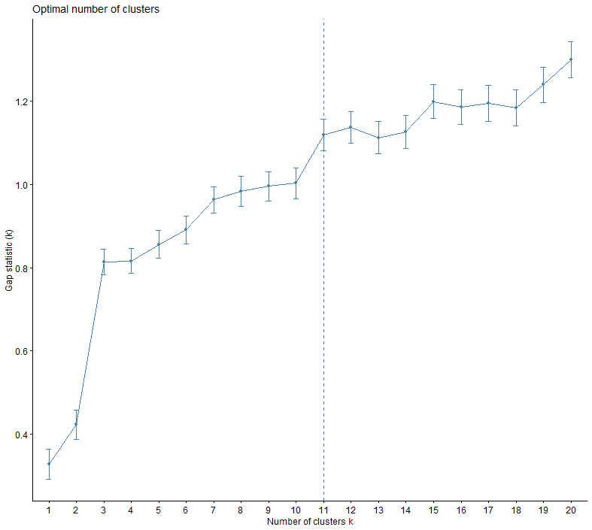
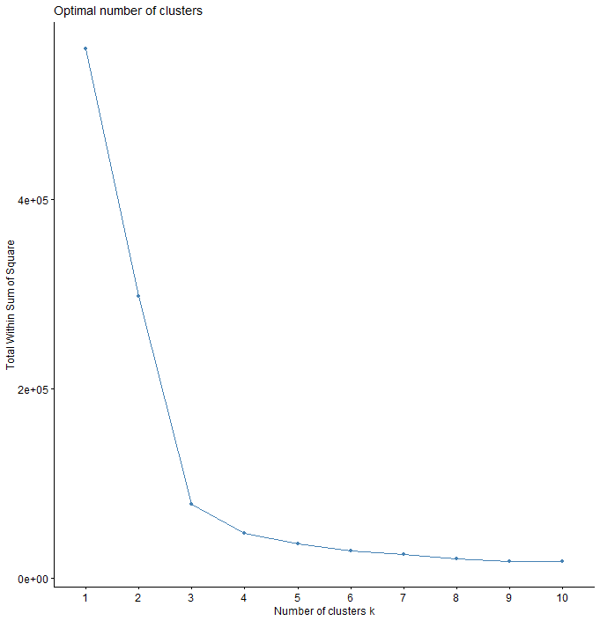

Slide 31
Total Country Connections (Top 6)
USA: 2451
CAN: 426
MEX: 374
GHA: 102
CUB: 78
PAN: 63

Slide 32
Tools Used
Coding
R
Python
Mapping/Visualization
Esri ArcGIS online
Esri StoryMaps
Tableau
NextStrain

Slide 33
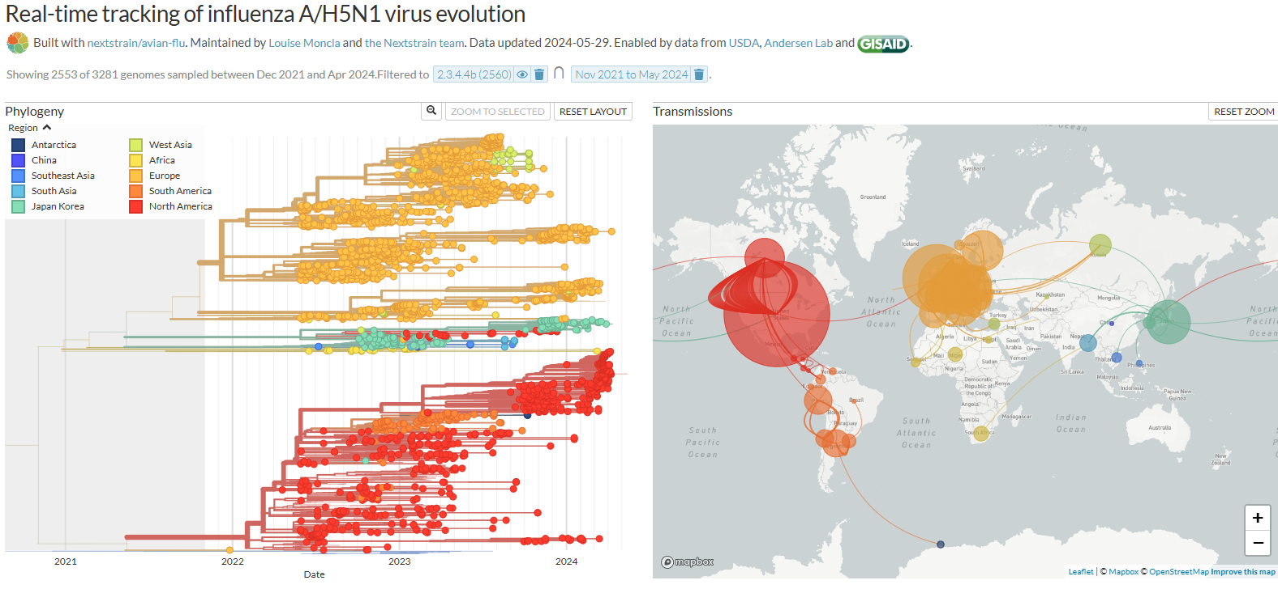

Slide 34
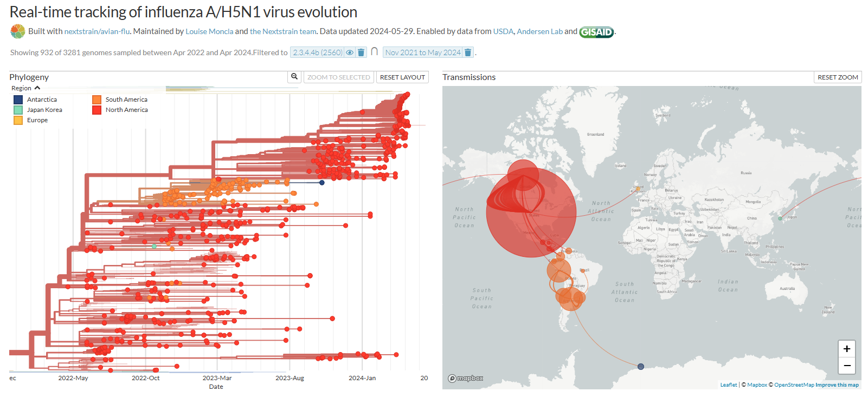
Via NextStrain

Slide 35
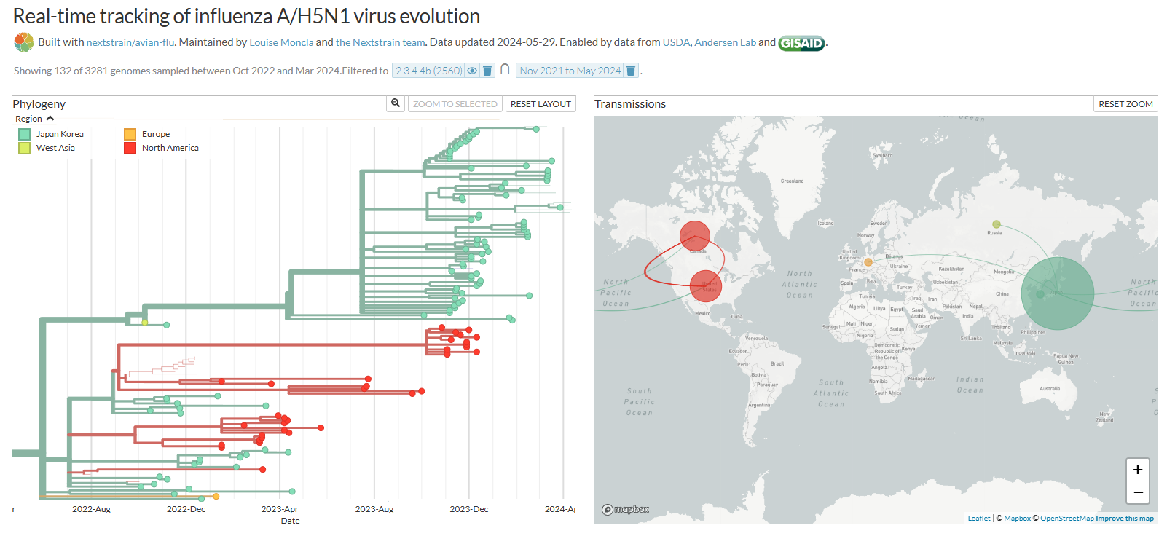
Via NextStrain

Slide 36
Distinct Source Events per Country
France: 350
Canada: 258
Netherlands: 184
United Kingdom:153
Japan: 101
Spain: 36
Denmark: 34
Belgium: 26
Mexico: 26
Korea (Rep. of): 19
Portugal: 19
Norway:15
Russia: 15
Ireland: 5
Faeroe Islands: 1
Greenland: 1

